Slide 1
R. Harini 821721243022 B.tech., Artificial Intelligence and Data Science – IIIyear Sir Issac Newton College Of Engineering And Technology
3/21/2024 Annual Review

Slide 2
PROJECT TITLE
Image classification
(using CNN)

Slide 3


AGENDA
The agenda of Image classification using Convolutional Neural
Networks (CNNs) involves the use of deep learning techniques to classify
Images. To categorize and represent the image as a unique gray scale image, and then
convert the pixels into 2D array matrix. This project includes several key tasks:
Image preprocessing
Feature Extraction
Selection of training samples
Selection of suitable classification approaches
Post-classification processing
Accuracy Assessment
This task has several broader objectives and potential applications
3/21/2024 Annual Review

Slide 4

PROBLEM STATEMENT
The task of Image Classification using CNN, is to develop a machine learning model capable of accurately classifying images into predefined categories or labels.
The model should be trained on a dataset of labeled images and should be able to generalize well to unseen images.
The goal to achieve high accuracy in classifying images, while also considering factors such as computational efficiency, scalability, and interpretability.
3/21/2024 Annual Review

Slide 5

PROJECT OVERVIEW
The project involves implementing the image classification using CNN, highlighting the importance of image classification in various fields such as healthcare, autonomous vehicles, agriculture, etc.
Mention the significance of leveraging machine learning and deep learning techniques for accurate classification tasks.
Image classification is the process of categorizing and labeling groups of pixels or vectors within an image based on specific rules.
The categorization law can be devised using one or more spectral or textural characteristics.
3/21/2024 Annual Review

Slide 6

WHO ARE THE END USERS?
In an image classification project, the end users can vary depending on the specific application domain and the context in which the classification system is deploy.
Researchers and Data Scientists
Developers and Engineers
Business Stakeholders
End Users in Specific Industries
Consumers
Overall, the end users of an image classfication project can vary widely depending on the application domain, and it's essential to consider their needs, preferences, and expertise during system design, development, and deployment.
3/21/2024 Annual Review

Slide 7

YOUR SOLUTION AND ITS VALUE PROPOSITION
Our image classification solution provides a robust framework for accurately categorizing images into predefined classes or categories. Leveraging advanced machine learning and deep learning techniques, our system offers high levels of accuracy.
By employing efficient training strategies and optimization algorithms. Moreover, our solution is customizable and adaptable, allowing users to tailor the classification system to their specific needs and integrate it seamlessly into existing workflows.
Overall, our image classification solution delivers tangible value by enhancing efficiency, facilitating decision-making, and driving innovation in the field of computer vision.
3/21/2024 Annual Review

Slide 8

THE WOW IN YOUR SOLUTION
Our image classification solution introduces a groundbreaking approach that revolutionizes the way we interpret and categorize visual data.
What truly sets our solution apart is its seamless integration of advanced algorithms with user-friendly interfaces, empowering users to effortlessly navigate and leverage the power of image classification for their specific needs.
Moreover, our system's ability to adapt and evolve alongside evolving data and user requirements ensures long-term relevance and sustainability.
With each classification, our solution delivers not just results, but a transformative experience that inspires awe and unlocks new possibilities in the realm of computer vision.
3/21/2024 Annual Review
8

Slide 9
MODELLING
In image classification, effective modeling is the cornerstone of success, and our approach is engineered to excel in this crucial aspect.
Our modeling strategy involves a blend of innovative techniques such as convolutional neural networks (CNNs), recurrent neural networks (RNNs), and attention mechanisms, carefully orchestrated to extract and leverage meaningful features from images with unparalleled accuracy and efficiency.
In essence, our modeling paradigm represents a beacon of innovation, driving transformative advancements and unlocking new frontiers in the field of computer vision.
3/21/2024 Annual Review
9

Slide 10
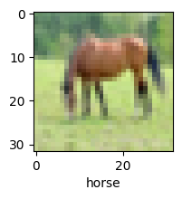
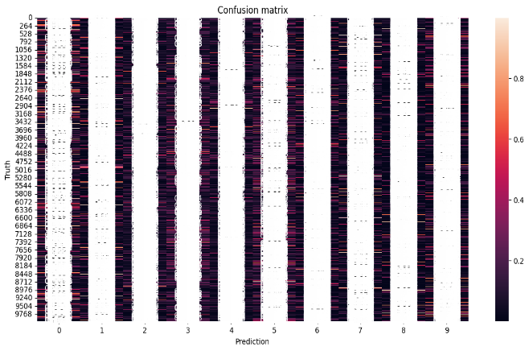
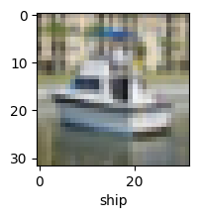
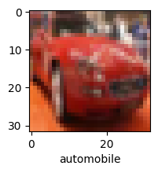
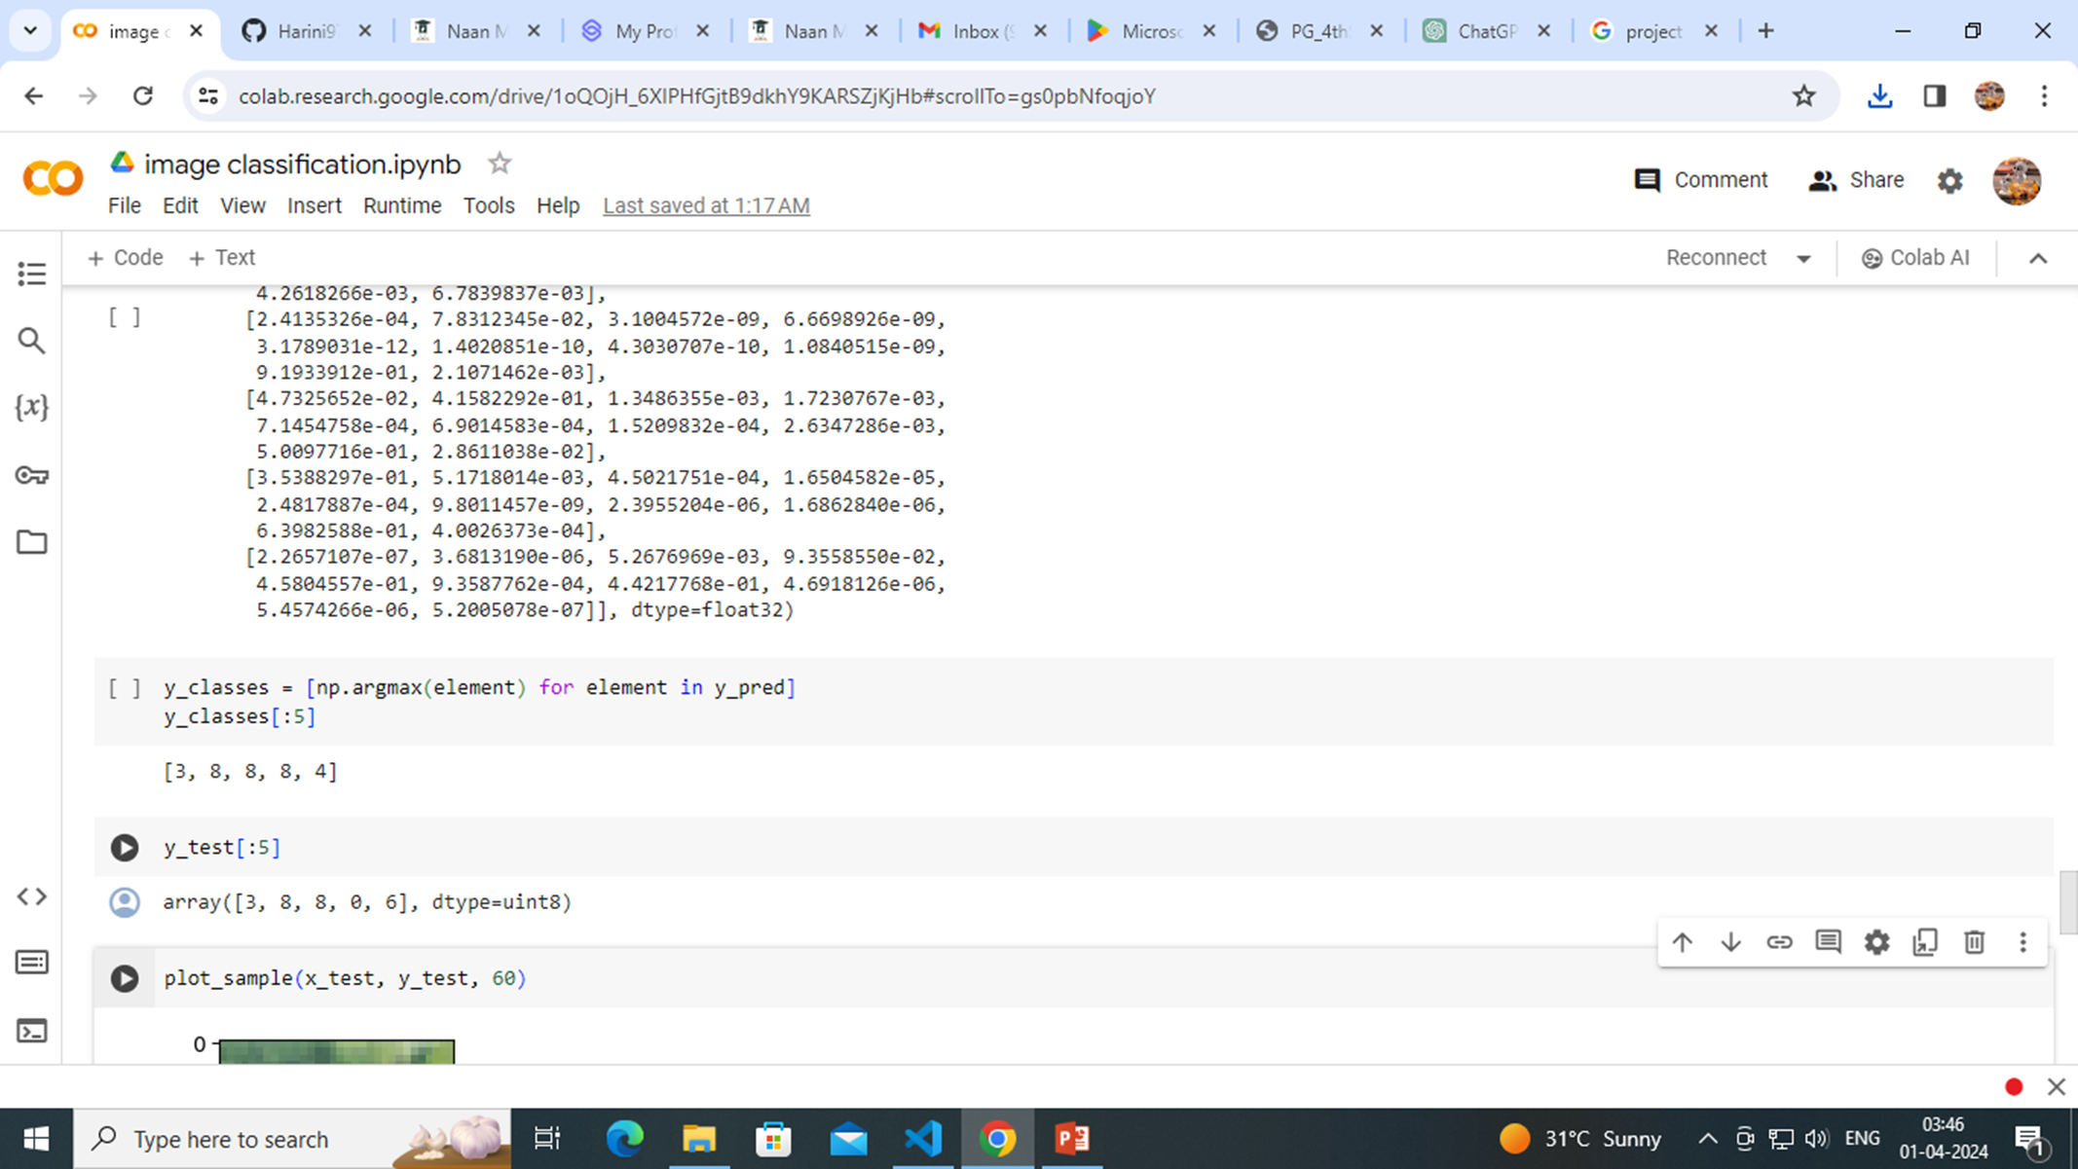
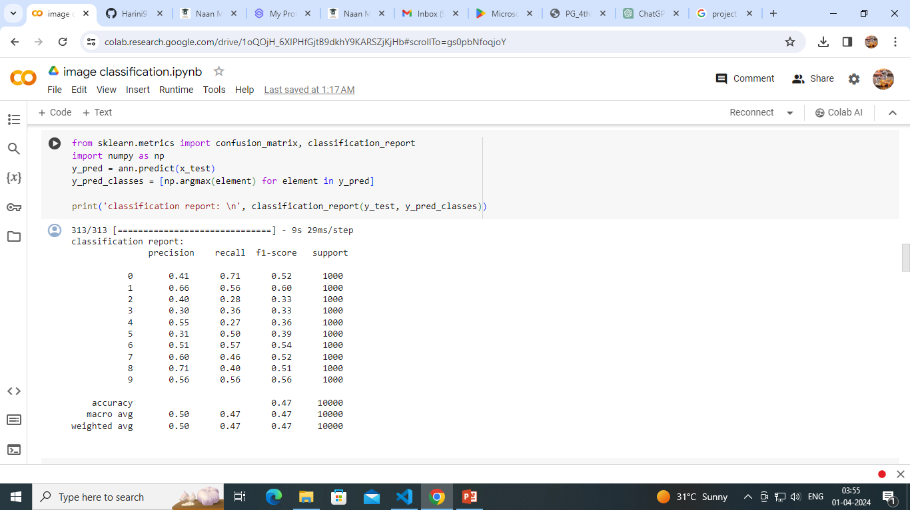
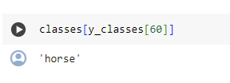
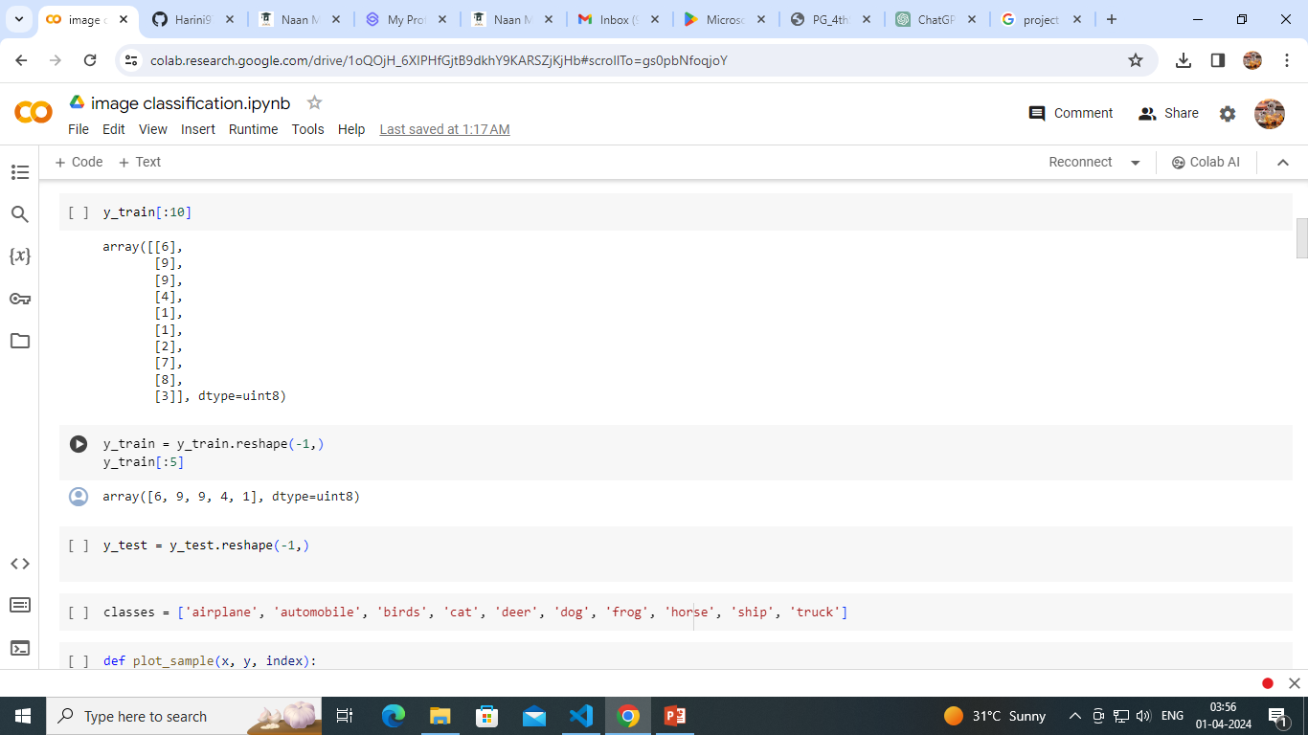
RESULTS
Demo Link
3/21/2024 Annual Review
10

